Slide 1
Systems Analysis and Design
Course Code: CSE 305
Instructor:
Dr. Shah Murtaza Rashid Al Masud
Assoc. Prof. CSE Dept., UAP

Slide 2
The Feasibility Study
Systems Analysis and Design
The objective of a feasibility study is to find out if an information system project can be done, and if so, how.
A feasibility study should tell management:
Whether the project can be done;
What are alternative solutions?
What are the criteria for choosing among them?
Is there a preferred alternative?
After a feasibility study, management makes a go/no-go decision.

Slide 3
Dimensions of Feasibility
Systems Analysis and Design
Operational -- how will the solution work?
Technical -- is the technology needed available? Can we build it?
Economic -- return on investment. Should we build it?
Schedule -- can the system be delivered on time?
Organizational feasibility: If we build it, will they come?

Slide 4
Feasibility Analysis
1 | Technical Feasibility | Familiarity with application: Less familiarity generates more risk Familiarity with technology: Less familiarity generates more risk Project size: Large projects have more risk Compatibility: The harder it is to integrate the system with the company’s existing technology, the higher the risk will be
2 | Economic Feasibility | Return on Investment (ROI) Break Even Point (BEP) Intangible Benefit
3 | Organizational Feasibility | Is the software project strategically aligned with the business?

Slide 5
Technical Feasibility
Familiarity with application | Knowledge of business domain Need to understand improvements Need to recognize pitfalls and bad ideas
Familiarity with technology | Is technology new to this organization? Is this a brand new technology? Extension of existing firm technologies
Project size | Number of people, time, and features
Compatibility | Systems are not built in a vacuum Needs to integrate with current systems and data

Slide 6
Economic Feasibility
Information Systems Analysis and Design
The bottom line for many projects!
Economic feasibility amounts to judging whether possible benefits of the project are worthwhile.
As soon as a specific solution has been identified, the analyst can weigh the costs and benefits of each alternative.
This is called cost-benefit analysis.

Slide 7
Cost/Benefit Analysis
Information Systems Analysis and Design
The purpose of a cost/benefit analysis is to answer questions such as:
Is the project justified (benefits outweigh costs)?
Can the project be done, within cost constraints?
What is the minimal cost to attain a certain system?
Difficulties -- discovering and assessing benefits and costs; they can both be intangible, hidden and/or hard to estimate, it's also hard to rank multi-criteria alternatives

Slide 8
Types of Benefits
Information Systems Analysis and Design
Benefits may be classified into one of the following categories:
Monetary -- when $-values can be calculated;
Tangible (Quantified) -- when benefits can be quantified, but $-values can't be calculated;
Intangible -- when neither of the above applies.
How to identify benefits? By organizational level (operational, lower/middle/higher management) or by department (production, purchasing, sales,...)

Slide 9
Types of Costs
Information Systems Analysis and Design
Project-related costs
Development and purchasing costs;
Installation, training and conversion costs.
Operational costs (on-going)
Maintenance: hardware, software, facilities
Personnel: operation, maintenance.
For a small business that wants to introduce a PC-based information system, these cost categories amount to:
Project costs: purchase hardware, software, furniture; customize software, train, install, file conversion
On-going costs: operating the system (data entry, backups, helping users, vendors etc.), maintenance (software) and user support, hardware and software maintenance, supplies,...

Slide 10
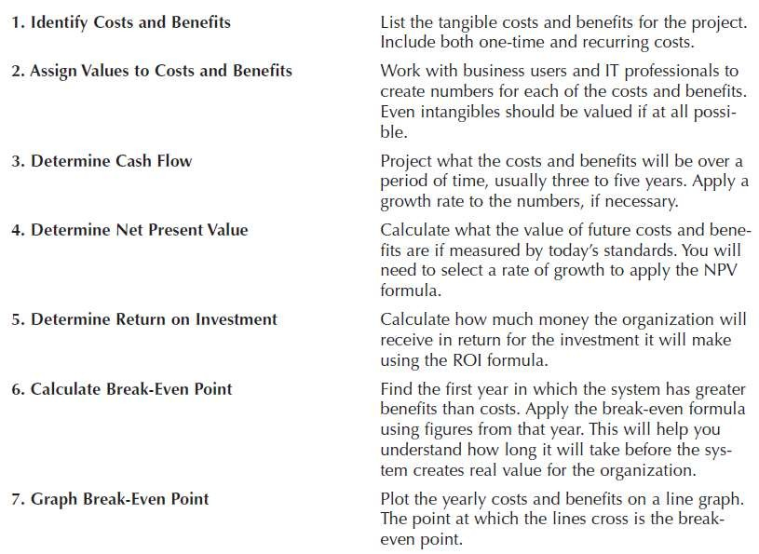
Economic Feasibility: Should We Build It?

Slide 11
Cost-Benefit Analysis - Cash Flow
Project costs and benefits over several years (3–5)
Use normal growth rates for sales etc.
Total added to determine
Overall Benefits = Total Benefits – Total Costs
Higher number is better

Slide 12
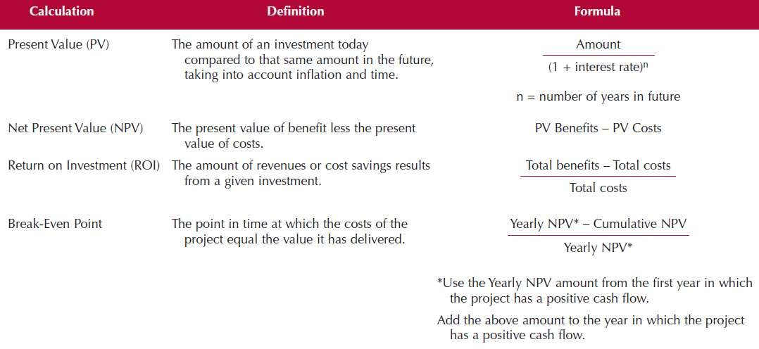
Cost-Benefit Analysis - Cash Flow

Slide 13
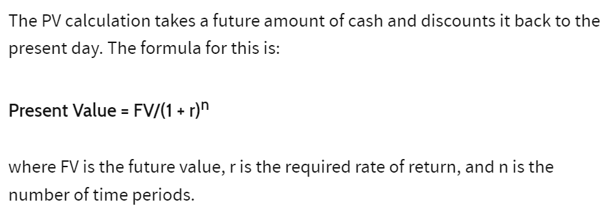

Present Value (PV)
Information Systems Analysis and Design

Slide 14
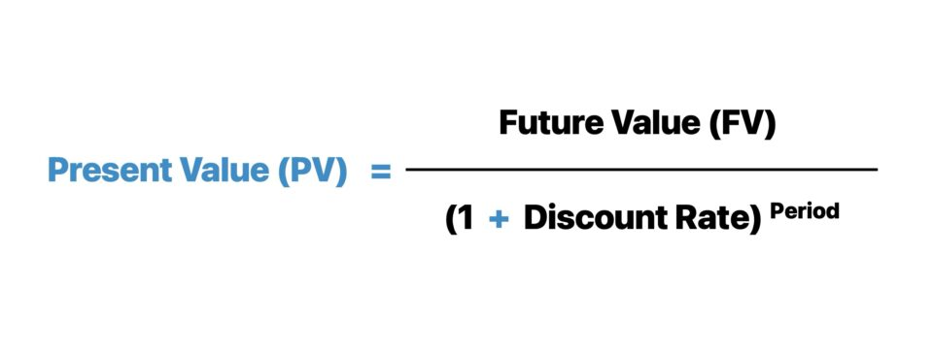
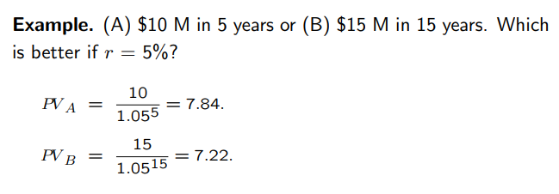
Present Value (PV)
Information Systems Analysis and Design

Slide 15
Present Value (PV)
Systems Analysis and Design

Slide 16
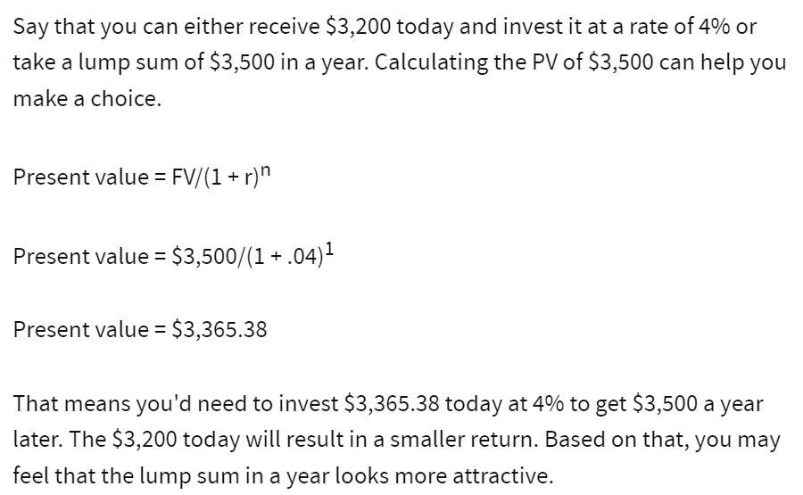
Present Value (PV)
Information Systems Analysis and Design

Slide 17
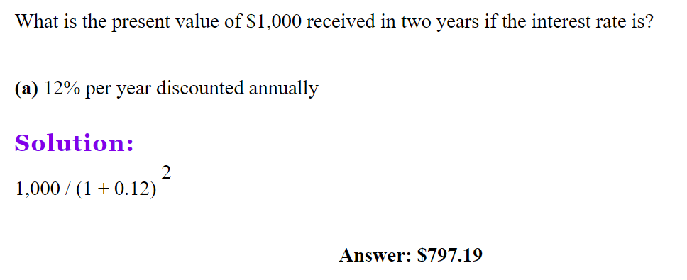
Present Value (PV)
Information Systems Analysis and Design

Slide 18
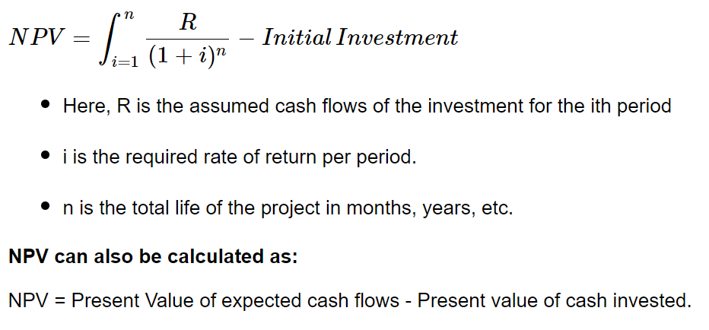
Net Present Value (NPV)
Information Systems Analysis and Design
The net present value formula calculates NPV, which is the difference between the present value of expected cash flows and the present value of cash invested, over a period of time.
We can say, NPV = PV-cash invested

Slide 19
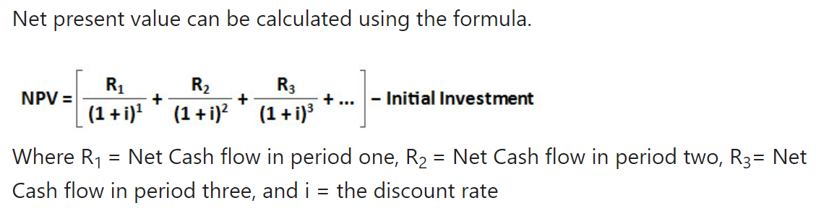
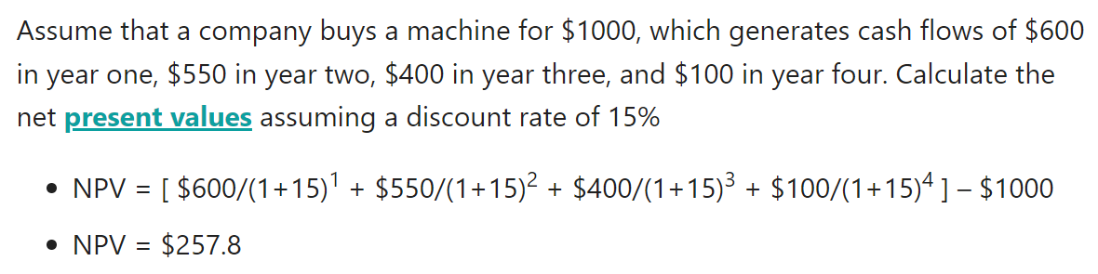
Net Present Value (NPV)
Information Systems Analysis and Design

Slide 20
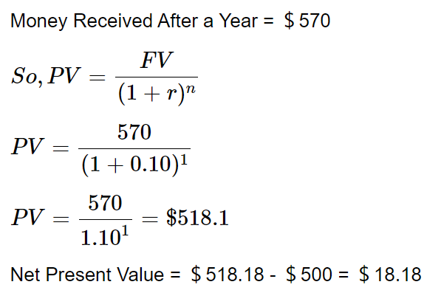
Net Present Value (NPV)
Information Systems Analysis and Design
One of your friends needs ＄500 now and promised to pay you back ＄570 in a year. Is that a fruitful investment when you can invest at 10% elsewhere?
Solution:
Money Invested Now = ＄500
Therefore, at 10%, the investment is worth ＄18.18.
In other words, it states that ＄18.18 is better than a 10% investment in today’s value of money.

Slide 21
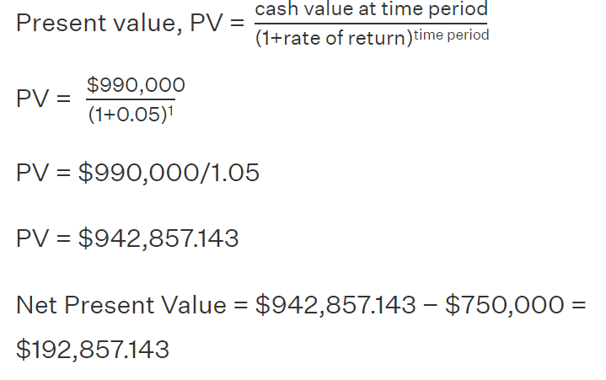
Net Present Value (NPV)
Information Systems Analysis and Design
Mr. XYZ bought a house for $750,000 and sells it a year later for $990,000, after deducting any realtor's fees and taxes. Calculate net present value, if the rate of return is 5%.
Solution:
Given:
Investment on buying the house = $750,000
Monet received from sale a year later = $990,000
Rate of return = 5% = 0.05
Using net present value formula,
Therefore, for 5% rate of return, investment has NPV = $192,857.143

Slide 22
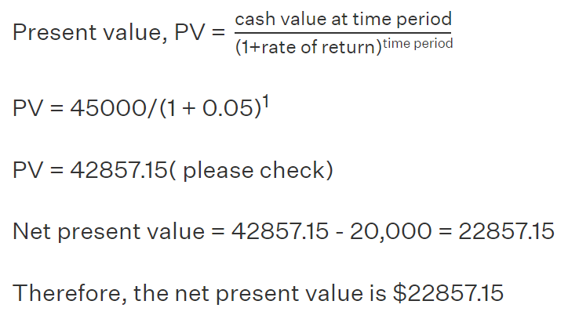
Net Present Value (NPV)
Information Systems Analysis and Design
If the rate of return is 5%, what would be the net present value of a box of fruits with the price at $20,000 and a year later it costs $45,000.
Solution: Given,
Current price of box = $20,000
Year later = $45,000
Rate of return = 5% = 0.05
Using the net present value formula,

Slide 23
Cost-Benefit Analysis - Cash Flow

Slide 24
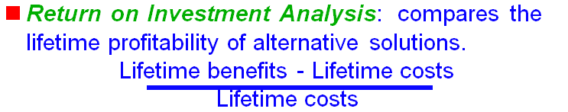
Return on Investment (ROI)
The Amount of revenue or cost savings results from a given investment
ROI =
Total Benefits – Total Costs
Total Costs

Slide 25
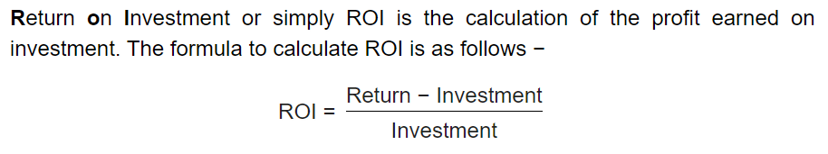
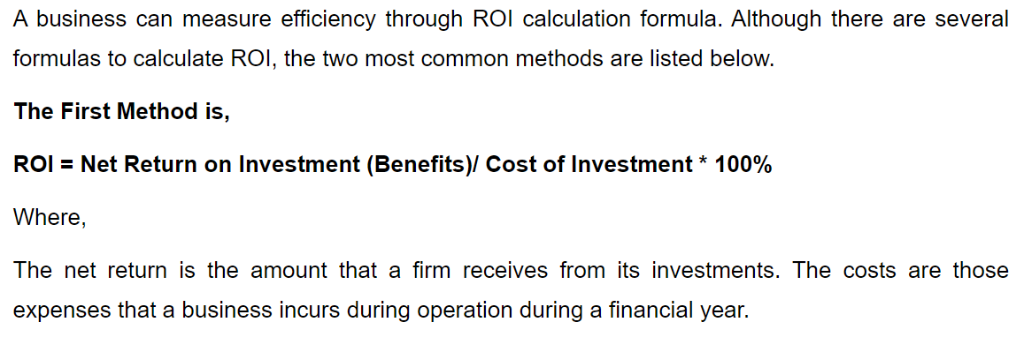
Return on Investment (ROI)

Slide 26
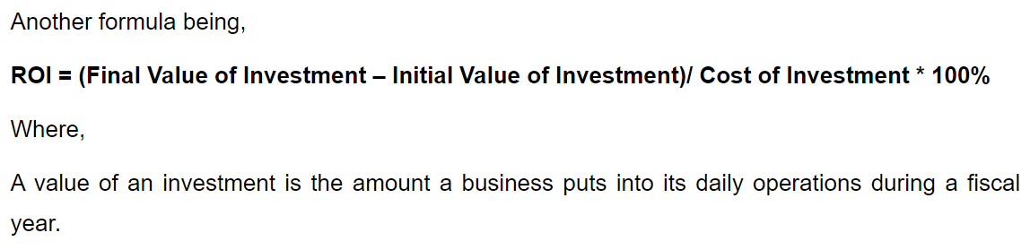
Return on Investment (ROI)
Suppose, the cost of implementing a program amounts to Tk.30,000 and the savings accumulated in the process is Tk.50,000. The ROI can be ascertained as:
ROI = Tk. (50,000 – 30,000)/ Tk.30,000 *100
= 66.67%
It implies that for every 1 Taka spent, its return on investment is Tk.0.6667.

Slide 27
Return on Investment (ROI)
Another simple example of ROI is, the cost summary of business is Tk.20,000. It includes facilitation fees of Tk.11,000, materials costing Tk.2,000, salaries of staffs amounting Tk.7,000. The total annual benefit results as Tk.60,000.
The ROI will be calculated as:
ROI = Tk. (60,000 – 20,000)/ Tk.20,000 * 100
= 200%
It means that for all entire expense of Tk.20,000, its percentage return will be 200%.

Slide 28
How is ROI Beneficial for a Business?
In day to day functioning of a business, ROI plays a vital role. It has wide applications due to its numerous benefits, such as:
It assists all business heads, and other top management officials to understand the proper allocation of resources.
ROI guides all investors to take essential decisions by comparing the high-value and low-value investments.
It also helps in exploring and evaluating the potential gains from different opportunities.
It also guides an organisation in calculating its costs and understanding the possible threats of the market.

Slide 29
What are The Uses of ROI?
There are multiple uses of ROI in every aspect of an organisation. Some of them are listed below as:
It is an essential financial calculator useful for determining the value of returns of the past and the present.
The ROI is a simple ratio which has a universal application to evaluate the potential of profits.

Slide 30
Break Even Point (BEP)
Calculating your break-even point
To be profitable in business, it is important to know what your break-even point is. Your break-even point is the point at which total revenue equals total costs or expenses. At this point there is no profit or loss — in other words, you 'break even'.

Slide 31
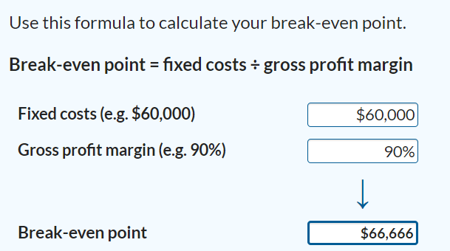
Break Even Point (BEP)

Slide 32
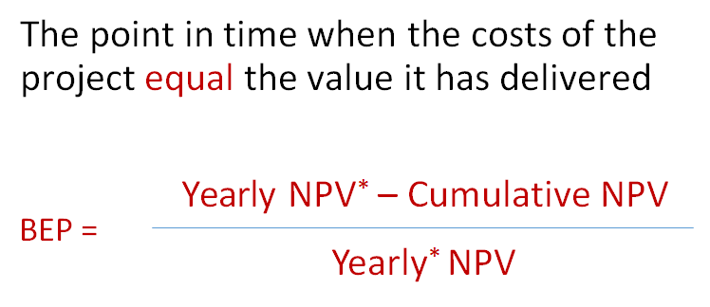
Or Break Even Point (BEP)
* Use the yearly NPV amount from the first year in which project has positive cash flow

Slide 33
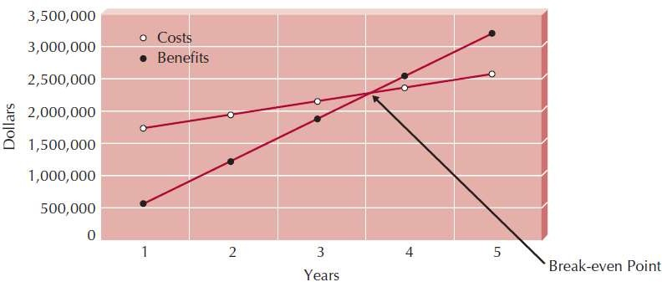
Break Even Point (BEP)

